Slide 1
Dodd-Frank Act Stress Test
UCLA Extension Winter 2020
By
Ming-chun Ho

Slide 2

Background:
Inception – Spring 2009
Reason – 2008 US Financial Crisis / Recession
Most Comprehensive Financial Reform Since 1929
Stress Test – Past, Present, Future
Present (prior to Coronavirus):
Duration – About a decade
Situation – US Economy In Expansion (Steady Rate)
This Supervisory Act Seems Working Well
Has The Stress Test Been Working Well ?

Slide 3
Data Description
Source: The Federal Reserve Website (Link)
Period: 2000 – 2017 (Quarterly-Base)
Count: N=111 vs N=72
N=111 (3 Hypothetical Scenarios (not forecasts) included)
N=72 (3 Hypothetical Scenarios excluded)
Variables: N=30 (Domestics vs International)
Date | Real Disposable Income Growth | 3-Month Treasury | BBB Corporate Yield | Dow Jones Index | VIX | Real GDP Growth (EU) | Real GDP Growth (APAC) | Real GDP Growth (JP) | Real GDP Growth (UK)
Real GDP Growth | Unemployment | 5-Year Treasury Yield | Mortgage | House Price Index | Type | Inflation (EU) | Inflation (APAC) | Inflation (JP) | Inflation (UK)
Nominal GDP Growth | Real CPI Inflation | 10-Year Treasury Yield | Prime | Commercial Real Estate Price Index | Nominal CPI Inflation | Foreign Exchange (EU) | Foreign Exchange (APAC) | Foreign Exchange (JP) | Foreign Exchange (UK)

Slide 4

Approach And Technique
EDA
Linear Regression
Cross-Validation
PCH

Slide 5
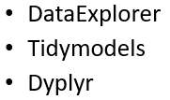
EDA Evaluation Outline
2 data frames evaluated
N=111 (Historical data + 3 scenarios)
N=72 (Historical data only)
3 packages to run “speedy” EDA
DataExplorer
Tidymodels
Dyplyr
Individual assessments applied to run “thorough” EDA

Slide 6
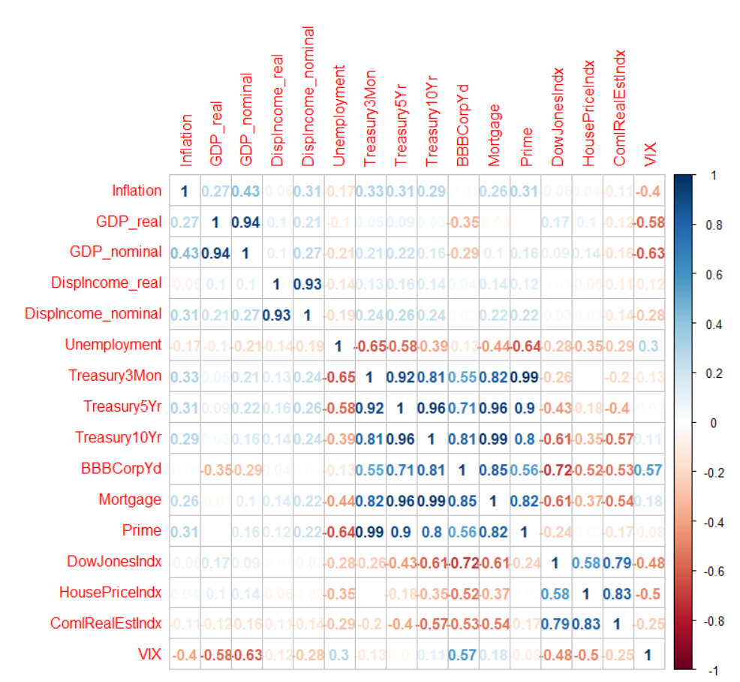
Correlation:
Stage1 Evaluation – Domestic Indicators
Remove 4 variables:
Real GDP
Real Disposable Income
5-Year Treasury Yield
10-Year Treasury Yield
Note: 3-Month Treasury Yield is to be kept!

Slide 7
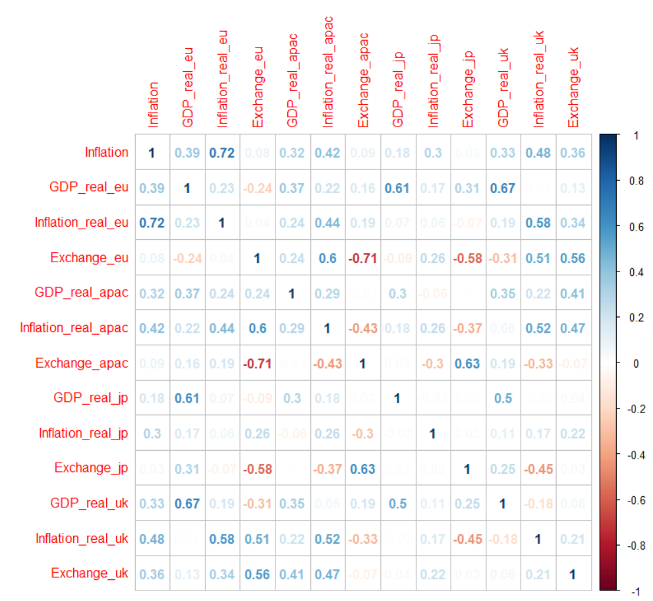
Correlation:
Stage2 Evaluation – International Indicators
Remove 3 variables:
EU Exchange Rate
APAC Exchange Rate
Japan Exchange Rate
Note: UK Exchange Rate is to be kept!

Slide 8
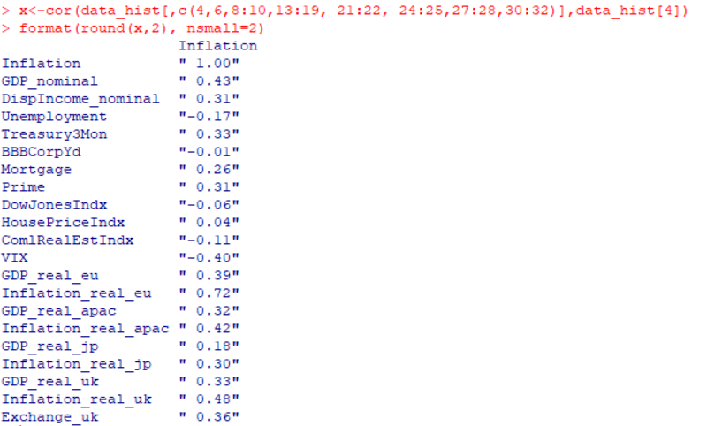
20 Selected Variables for further Analyses

Slide 9
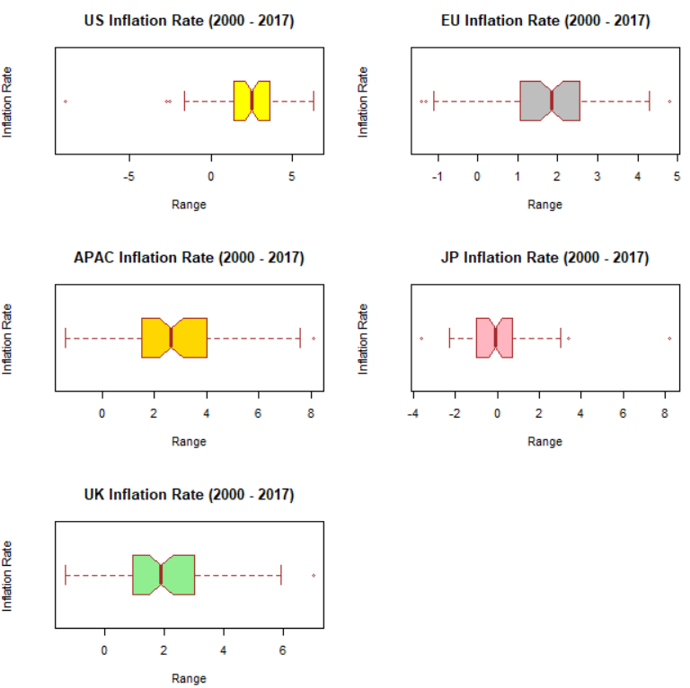
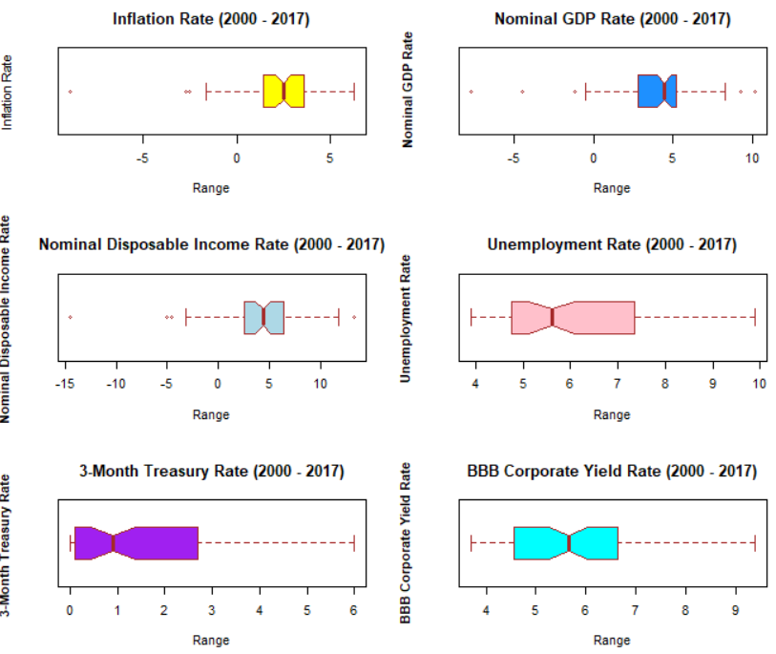
Main Domestic Indicators +
Inflation Across The Globe
US, UK and EU maintain Inflation around 2% while JP at 0% and APAC around 2.5-2.8%

Slide 10
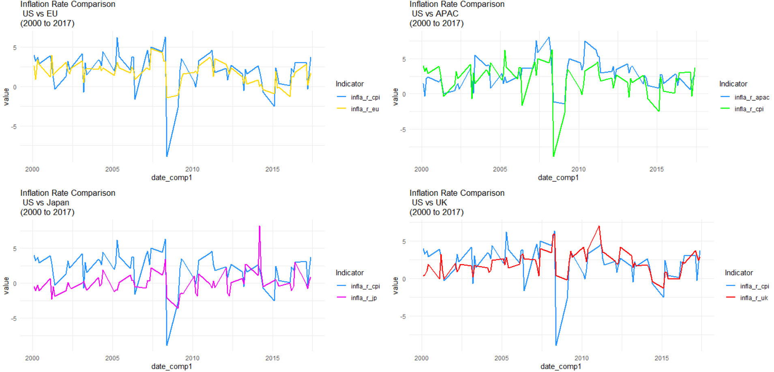
Inflation Comparison Across Global Major Markets / Regions
Overall, inflation follows relatively similar patterns b/t US and these regions/countries, at a reasonably steady rate since 2010.

Slide 11
Multiple Linear Regression

Slide 12
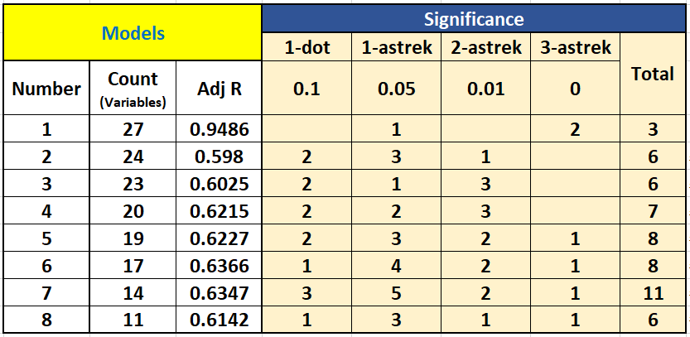
Full Model
Eval Real vs Nom’l + 10Yr-T
Eval 5Yr-T
Eval Exchange Rate
Eval GDP Rate
Eval Index.
Eval Int’ Var.
Final Model

Slide 13
Cross-validation
RandomForest

Slide 14
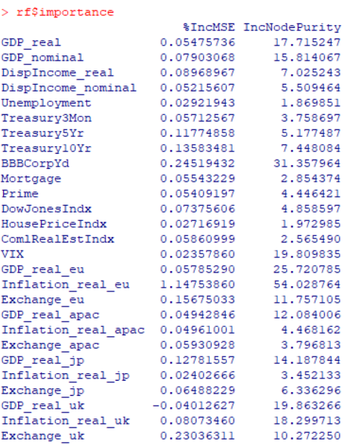
Train: 75%
Test: 25%
 | All | Train | Test
Error | 1.6039 | 1.6232 | 0.9858
Forecast result is satisfactory as test error is lower than train error – caveat: Dataset is small

Slide 15
Principle Component Analysis

Slide 16
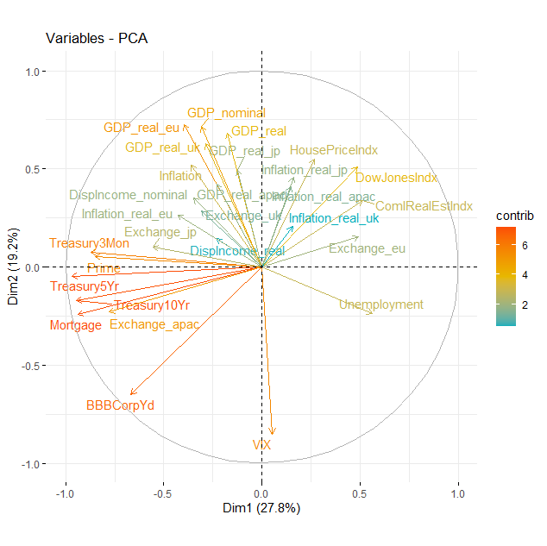
PCA affirms some variables chosen in Linear Regression!

Slide 17
Conclusion / Findings
Inflation rate is an important indicator in US economy as it is the current benchmark to assess and govern US economy.
Based on the trend analysis on US inflation and other indicators (not disclosed here), they suggest the patterns slightly fluctuate, yet they are at a relatively steady rate compared to the time period prior to 2008. Thus, Stress Test may contribute to this outcome.
In terms of the Multiple Linear Regression and Cross-Validation, they suggest Inflation can be predicted reasonably well and the importance of the chosen indicators suggests the quality of the data and its underlying can be a good reflection of true economic condition as a result.
GDP as a key indicator for economic evaluation somehow does not correlate well with other indicators (domestic and international)

Slide 18

Further Investigation
Micro Aspects
(i.e. individual banks)
Model Comparison / Cross-Validation Comparison

Slide 19
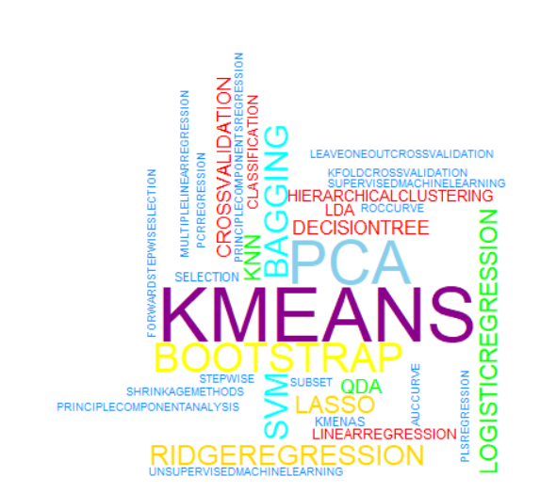
Thank You

